Slide 1
Organizational Development
SE495: Software Entrepreneurship

Slide 2
Outline
Introduction
Understanding Organizational Development
Organizational Structure and Design
Team Building and Management
Conflict Resolution and Negotiation
Organizational Culture and Communication
Case Studies

Slide 3
Introduction

Slide 4

Organizational Development
Organizational Development is the process of improving the efficiency, effectiveness, and overall performance of an organization.
In the context of software startups, it plays a crucial role in their ability to scale and succeed.

Slide 5
Why it Matters
Organizational development is a critical aspect of software entrepreneurship
Helps organizations adapt to changing market conditions and customer needs
Enhances employee engagement, motivation, and productivity
Supports the development of a competitive advantage
Essential for long-term success and sustainability

Slide 6
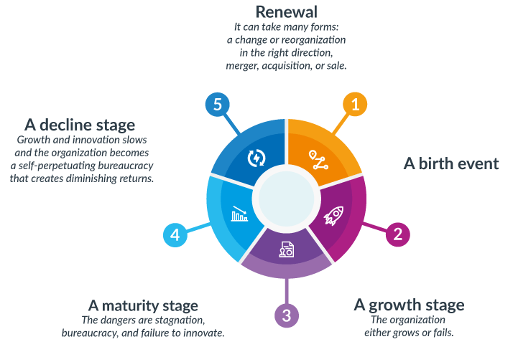
Stages of Organizational Development
Stage 1: Start-up
Stage 2: Growth
Stage 3: Maturity
Stage 4: Renewal
Stage 5: Transformation

Slide 7
Organizational Development Importance
Alignment of goals and objectives
Structured processes and systems
Talent acquisition and retention
Communication and collaboration
Adaptability and flexibility
Leadership development
Learning and continuous improvement

Slide 8
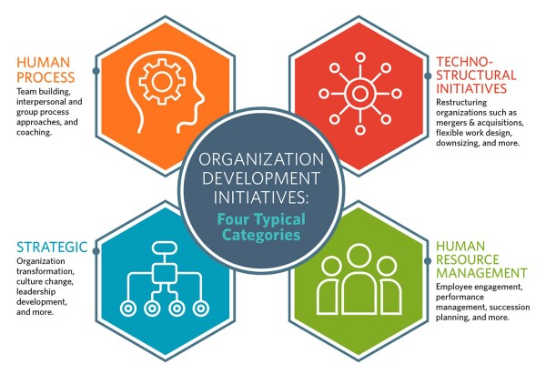
Key Drivers of Organizational Development
Leadership
Culture
Communication
Employee Engagement
Innovation
Adaptability

Slide 9
Understanding Organizational Development

Slide 10
Key Concepts and Principles of Organizational Development
Human capital
Organizational culture
Leadership
Change management
Performance management
Learning and development

Slide 11
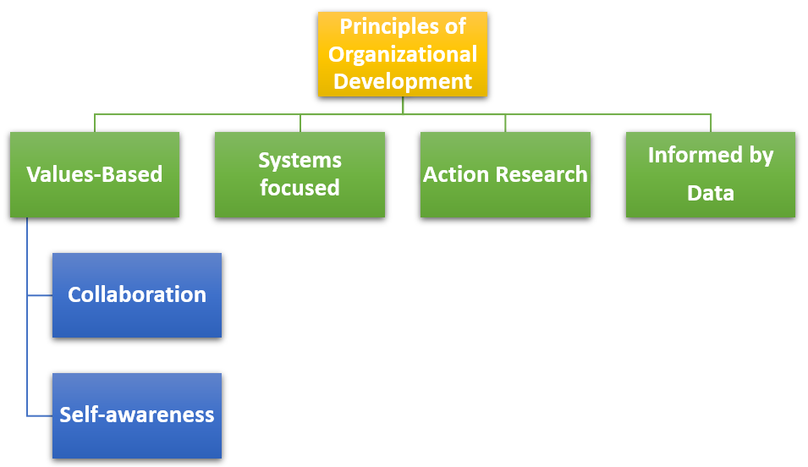

Slide 12
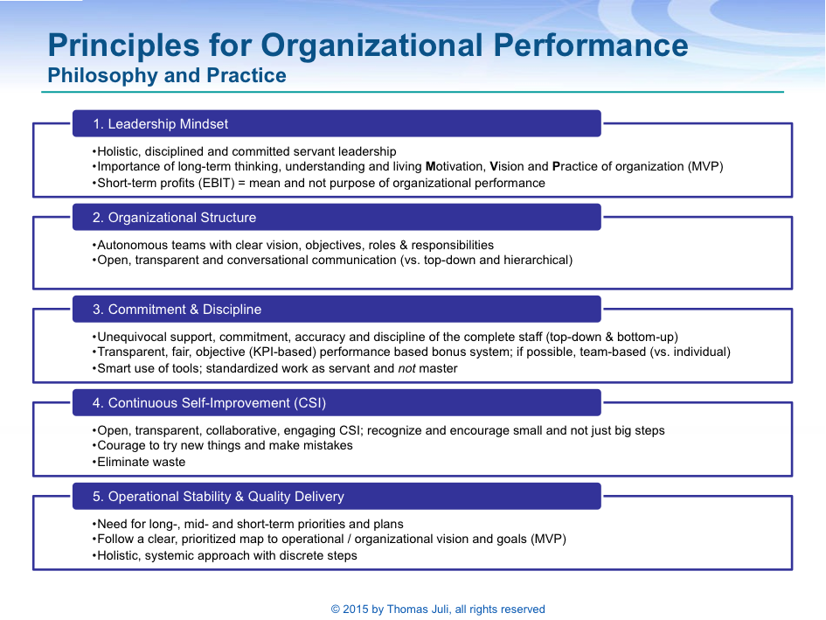

Slide 13
Importance
Improved collaboration and communication
Enhanced employee engagement and motivation
Better adaptability to changing requirements
Increased efficiency and productivity

Slide 14
Key Challenges
Resistance to change
Lack of clear vision and strategy
Insufficient communication and training
Limited resources

Slide 15
Best Practices
Establish a clear vision and strategy
Engage employees and stakeholders
Provide comprehensive training and development opportunities
Monitor and measure progress
Foster a culture of continuous improvement

Slide 16
Organizational Structure and Design

Slide 17
Organizational Structure
Organizational structure refers to the way in which an organization arranges its components, such as departments, teams, and individuals, to achieve its objectives.
It defines the hierarchy of authority, roles, and responsibilities within the organization.

Slide 18
Importance of Effective Organizational Design
Effective organizational design is critical to the success of an organization, as it enables the organization to achieve its objectives efficiently and effectively.
A well-designed organization structure can help to:
Improve communication and collaboration among employees
Clearly define roles and responsibilities
Enhance decision-making processes
Increase productivity and efficiency
Facilitate growth and change

Slide 19
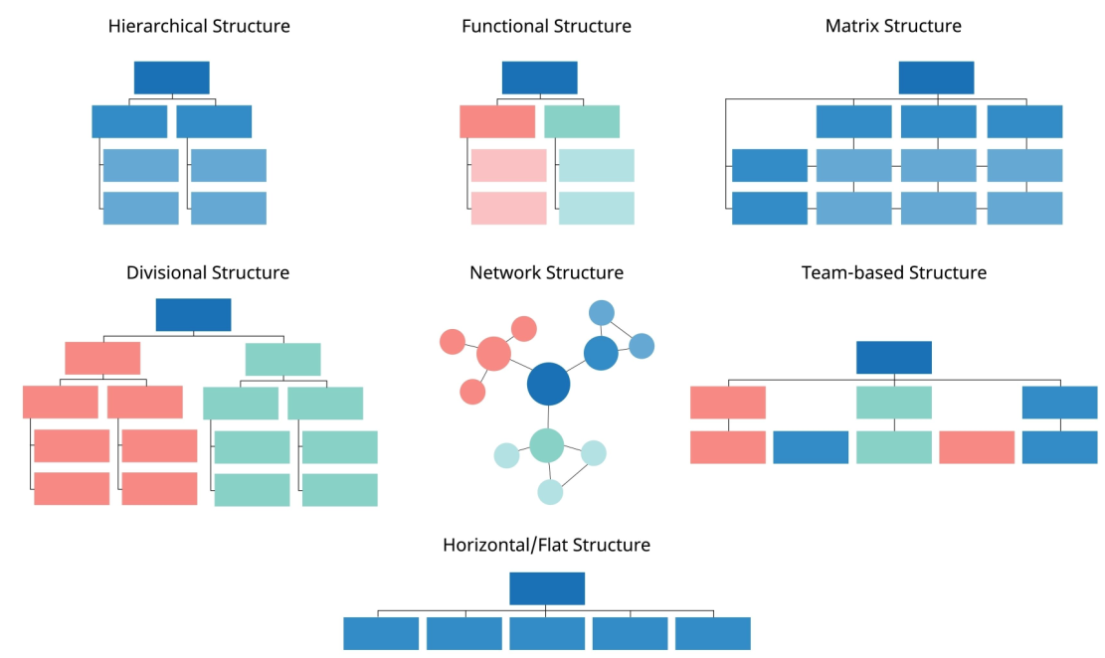
Types of Organizational Structures

Slide 20
Types of Organizational Structures
Functional
Divisional
Matrix
Team-Based
Clearly defined roles and responsibilities
Specialization and efficiency in each department
Easy to manage and control
Clearly defined roles and responsibilities
Each division has its own management and control
Flexibility and adaptability in responding to changing market conditions
Allows for both functional and divisional structures
Encourages collaboration and communication across departments
Flexibility and adaptability in responding to changing market conditions
Encourages collaboration and teamwork
Flexibility and adaptability in responding to changing market conditions
Empowers employees and promotes ownership
Communication and collaboration between departments can be challenging
Limited flexibility and adaptability
May not be suitable for organizations with diverse and complex products/services
May lead to duplication of resources and costs
Difficult to coordinate and control across divisions
May not be suitable for small organizations
Can be complex and difficult to manage
Conflicting priorities and roles can lead to confusion and inefficiencies
May not be suitable for organizations with a simple and straightforward structure
Can be challenging to manage and control
May lead to conflict and communication issues within teams
May not be suitable for organizations with a large number of employees

Slide 21
Key Considerations
Aligning structure with business goals and strategy
Defining roles and responsibilities
Assigning authority and decision-making powers
Ensuring effective communication and collaboration
Providing opportunities for growth and development

Slide 22
Importance of Scalability and Adaptability
Accommodating growth and change
Responding to market demands and customer needs
Encouraging innovation and agility
Maintaining efficiency and effectiveness
Enabling organizational learning and improvement

Slide 23
Overcoming Obstacles
Resistance to change
Lack of clear communication and vision
Inadequate training and support
Insufficient resources and funding
Cultural and organizational barriers

Slide 24
Team Building and Management

Slide 25
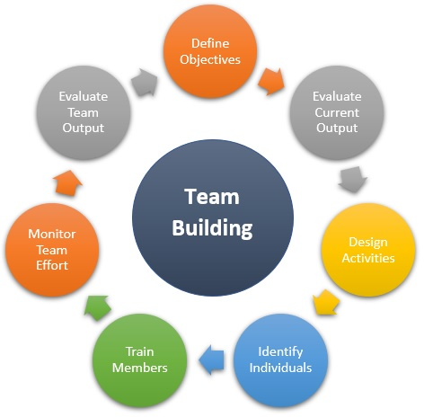
Team Building and Management
Building a strong team
Diverse skill sets
Collaboration and synergy
Motivation and morale
Effective communication
Adaptability and resilience
Talent attraction and retention
Innovation and creativity

Slide 26
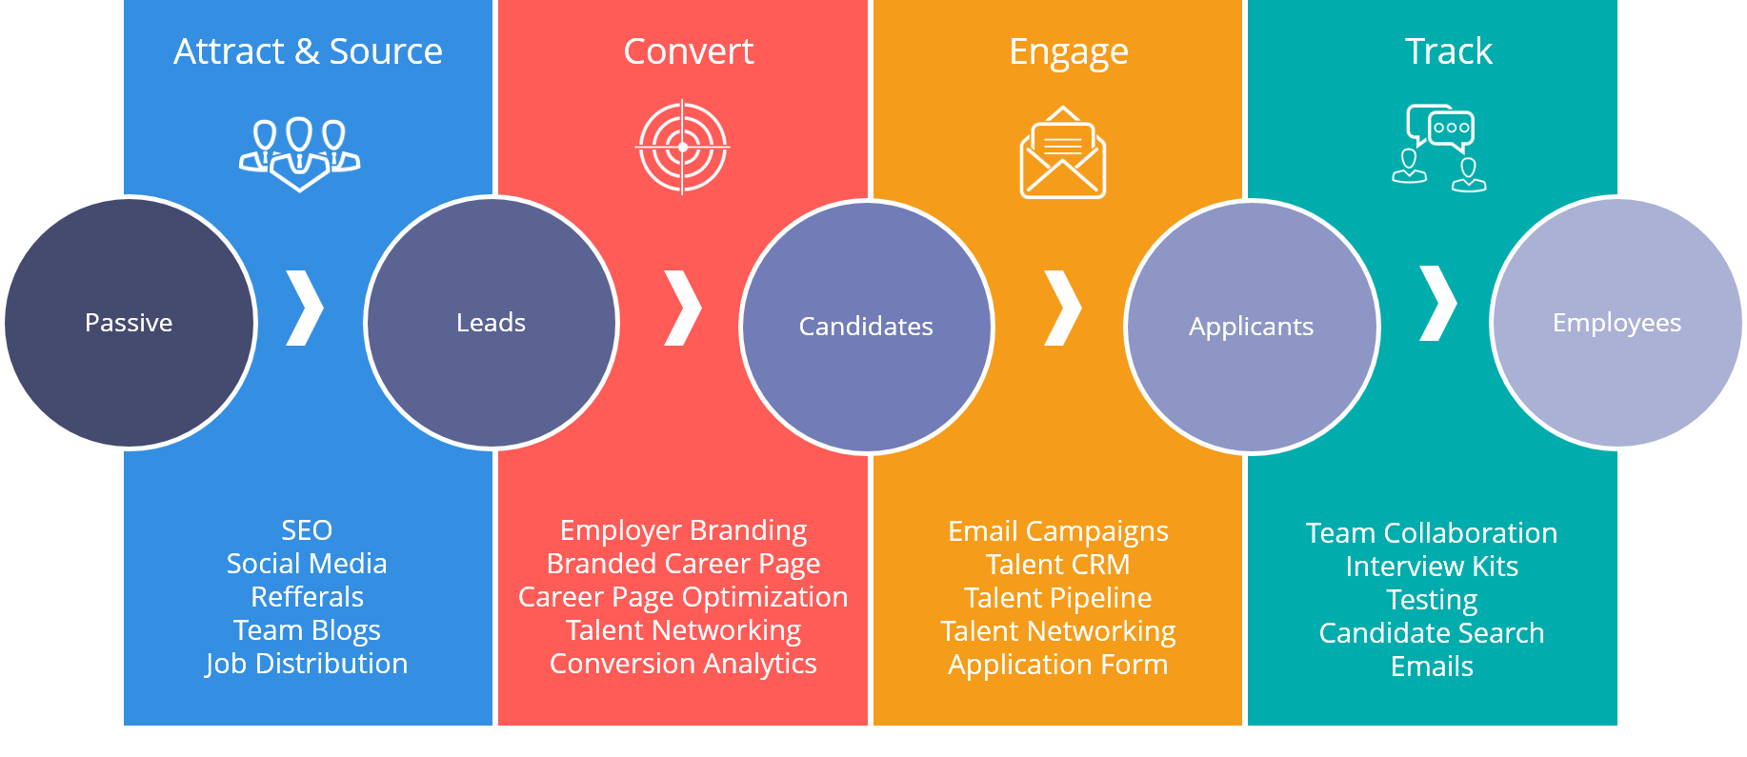
Hiring Process

Slide 27
Hiring Process
Define job roles
Source candidates
Screen and shortlist resumes
Conduct interviews
Assess skills and cultural fit
Check references
Make job offers

Slide 28
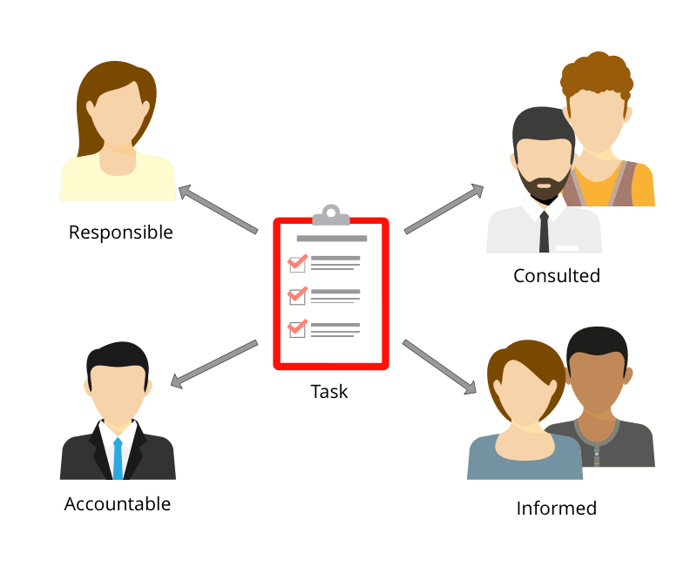
Roles and Responsibilities
Founder's role:
Setting the vision
Strategy development
Culture creation

Slide 29
Roles and Responsibilities
Team members' roles:
Defining clear roles
Collaboration and teamwork
Task execution
Continuous learning and improvement
Communication and transparency
Problem-solving and decision-making

Slide 30
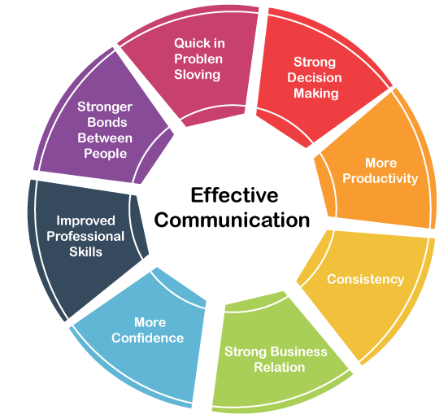
Effective Communication
Clear communication channels:
Weekly meetings
Email
Project management tools

Slide 31
Effective Communication
Active listening:
Provide a safe and open environment
Practice empathy
Repeat and summarize
Ask for clarification

Slide 32

Conflict Resolution and Negotiation

Slide 33
What?
Conflict resolution
The process of identifying and addressing conflicts in a way that is fair and constructive
Negotiation
The process of communicating and bargaining with others to reach a mutually beneficial agreement

Slide 34

Conflict Resolution
Conflict management is a crucial skill for startup teams to maintain a healthy and productive work environment.
Here are some approaches and techniques that can be used to address conflicts promptly and effectively:
Address conflicts promptly
Active listening and empathy
Mediation
Problem-solving and collaboration
Compromise and negotiation
Establish clear guidelines and policies
Learn from conflicts

Slide 35
Key Concepts and Strategies
Understanding conflict styles and modes
Approaches to conflict resolution
problem-solving, interest-based, and principled negotiation
Key negotiation tactics
anchoring, compromising, and collaborating
Importance of active listening and effective communication

Slide 36
Identifying and Addressing Conflicts
Identifying sources of conflict in software development teams
Understanding the impact of conflict on team performance and productivity
Strategies for managing conflict: negotiation, mediation, and problem-solving
Role of leadership in conflict management

Slide 37
Handling Difficult Conversations and Conflicts
Identifying difficult conversations and conflicts
Understanding the impact of difficult conversations and conflicts on software development teams
Strategies for handling difficult conversations and conflicts: active listening, empathy, and problem-solving
Role of emotional intelligence in conflict resolution

Slide 38
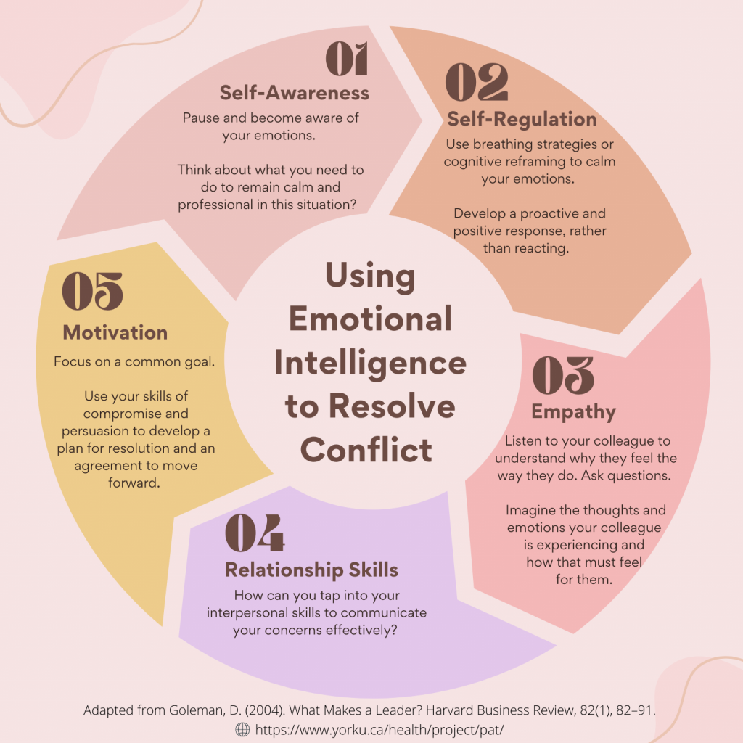

Slide 39
Organizational Culture and Communication

Slide 40
Organizational Culture
Organizational culture refers to the shared values, beliefs, attitudes, and behaviors that define an organization and influence its interactions with employees, customers, and stakeholders.
Culture is often seen as the underlying fabric that shapes an organization's identity and guides its decision-making processes.
In software development, organizational culture can have a significant impact on the success of a project, as it can affect the way team members communicate, collaborate, and approach problem-solving.

Slide 41
Importance
A strong and positive organizational culture can help software development teams to work more effectively and efficiently.
A culture that values collaboration, communication, and innovation can foster a sense of community and shared purpose among team members, leading to better project outcomes.
In contrast, a culture that is dysfunctional or toxic can lead to conflicts, misunderstandings, and poor performance.
Therefore, it is essential to intentionally cultivate a positive and supportive organizational culture in software development.

Slide 42
Key Concepts and Topics
Values and beliefs
Norms and expectations
Communication styles
Leadership styles
Conflict resolution
Organizational learning

Slide 43
Strategies and Best Practices
Importance of intentional culture-building
Strategies for creating a positive and productive culture:
Establishing clear values and norms
Encouraging open communication and feedback
Fostering collaboration and teamwork
Promoting continuous learning and improvement
Best practices for sustaining a positive culture

Slide 44
Overcoming Barriers and Improving Communication
Common communication challenges in software development teams:
Language and cultural barriers
Technical jargon and terminology
Different communication styles and preferences
Time zone and location differences
Strategies for overcoming communication challenges:
Establishing clear communication channels
Using collaboration tools and software
Encouraging open and honest communication
Providing training and resources

Slide 45
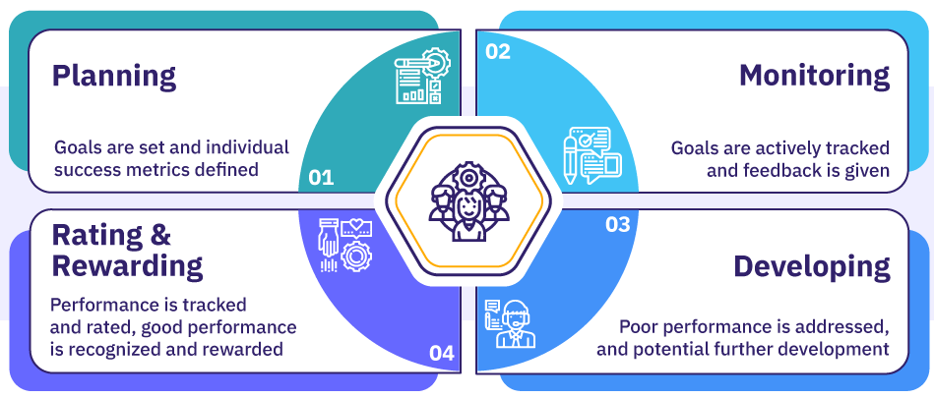
Performance Management
Setting goals and expectations:
Clear and measurable goals
Individualized goals
Regular goal review and alignment

Slide 46
Performance Management
Regular feedback:
Ongoing feedback
Constructive feedback
Recognition and rewards

Slide 47
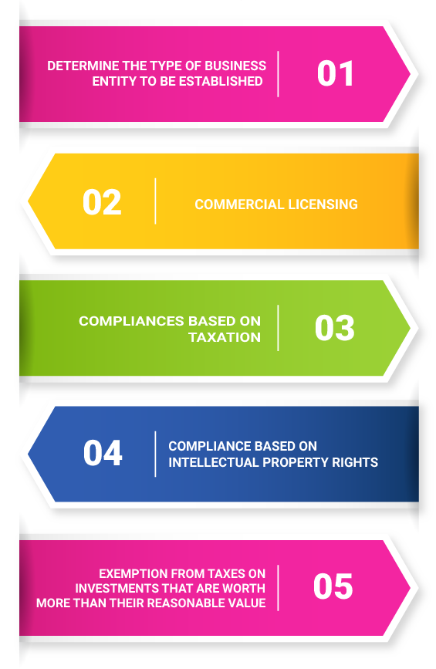
Legal Considerations
Protecting intellectual property (IP) is crucial for startups to safeguard their innovations and creations.
Two important aspects related to IP protection and incorporation:
Protecting IP:
Non-disclosure agreements (NDAs)
Copyrights
Patents
Incorporation:
Registering as a legal entity
Tax benefits

Slide 48
Accounting Basics
Financial statements:
Balance sheets
Income statements
Cash flow statements

Slide 49
Accounting Basics
Accounting methods:
Cash basis accounting
Accrual basis accounting

Slide 50
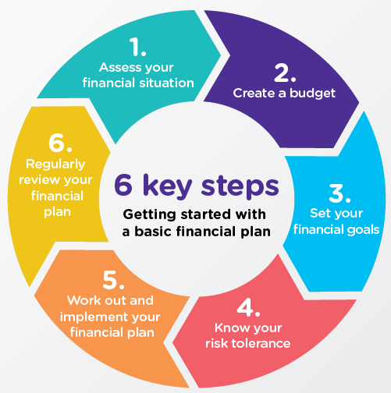
Financial Planning
Budgeting
Creating a comprehensive budget to manage expenses and forecast revenue.
Cash flow management
Ensuring sufficient cash reserves for operations and growth.

Slide 51

Fundraising
Bootstrapping
Financing the startup through personal savings, revenue, and cost-cutting measures.
Angel/seed investors
Pitching to angel investors or seed-stage venture capitalists for funding.

Slide 52

Financial Management
Financial forecasting
Creating realistic revenue and expense projections.
Cost control
Monitoring and controlling expenses to optimize profitability.

Slide 53
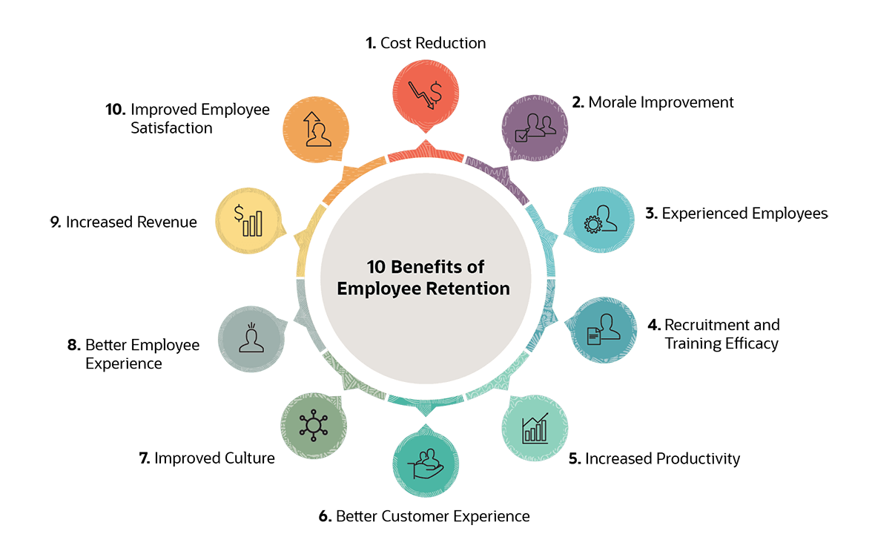
Retention and Motivation
Employee retention
Implementing strategies to retain top performers (e.g., equity, bonuses).
Motivation
Creating a motivating work environment through recognition, rewards, and opportunities for growth.

Slide 54
Case Study: GitHub

Slide 55

Background
GitHub was founded in 2008 and quickly became the go-to platform for software developers to collaborate and share code.
The company grew rapidly, and by 2015, it had over 100 employees.
However, as the company grew, the founders realized that their flat organizational structure and lack of formal processes were causing problems.

Slide 56
Issues
Lack of Clear Communication:
GitHub's flat structure meant that there were no clear channels for communication, and employees often had to rely on informal networks to get information.
Inefficient Decision-Making Process:
GitHub's decision-making process was slow and inefficient.
Inadequate Performance Management:
GitHub had a lack of effective performance management.
Poor Employee Engagement:
GitHub had a high turnover rate, and employees often reported feeling disengaged and unvalued.

Slide 57
Solution
GitHub implemented several organizational development initiatives.
Establishing a clear communication channel that included regular town hall meetings, departmental meetings, and one-on-one check-ins between managers and employees.
Developing a performance management system that included regular feedback and evaluations.
GitHub focused on building a positive company culture.
GitHub established a clear career development path for employees, providing opportunities for growth and advancement within the company.

Slide 58
Results
After implementing these organizational development initiatives, GitHub saw a significant improvement in their operations and culture.
Communication improved, decision-making became more efficient, and employee engagement and retention increased.
The company was able to respond more quickly to changing market conditions, and productivity and morale improved.
In 2018, Microsoft acquired GitHub for $7.5 billion, a testament to the company's success in addressing its organizational development challenges.

Slide 59
Conclusion
GitHub's experience highlights the importance of organizational development in supporting the growth and success of a tech startup.
By addressing issues such as communication, decision-making, performance management, employee engagement, and career development, tech startups can create a strong foundation for growth and success.

